Slide 1
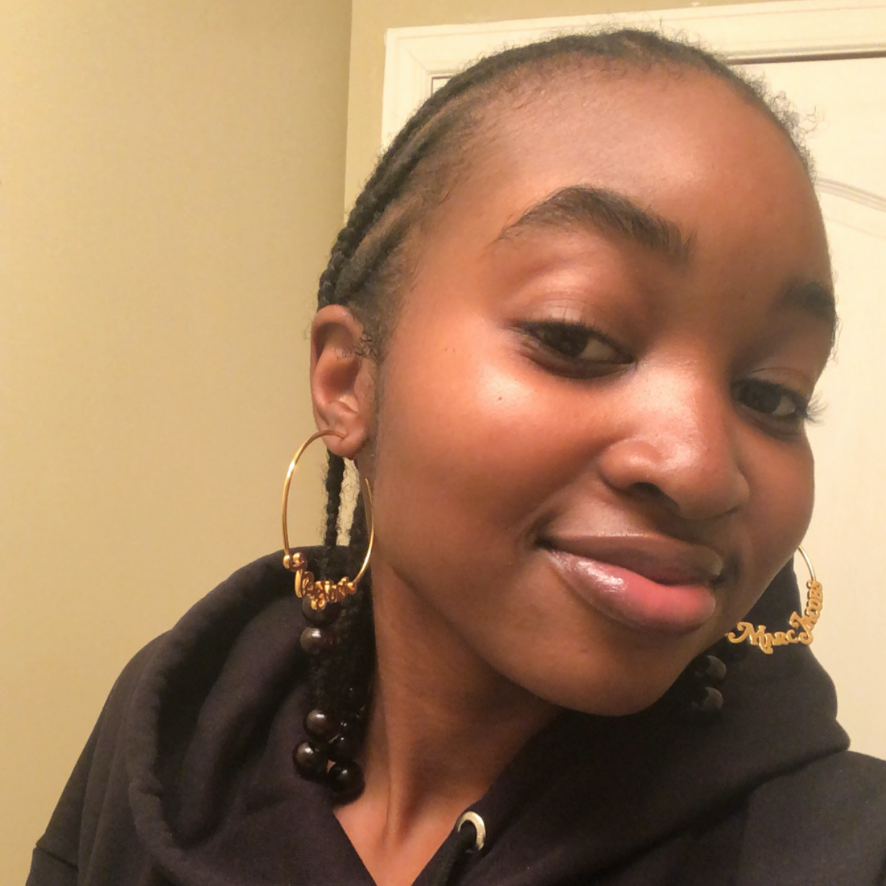
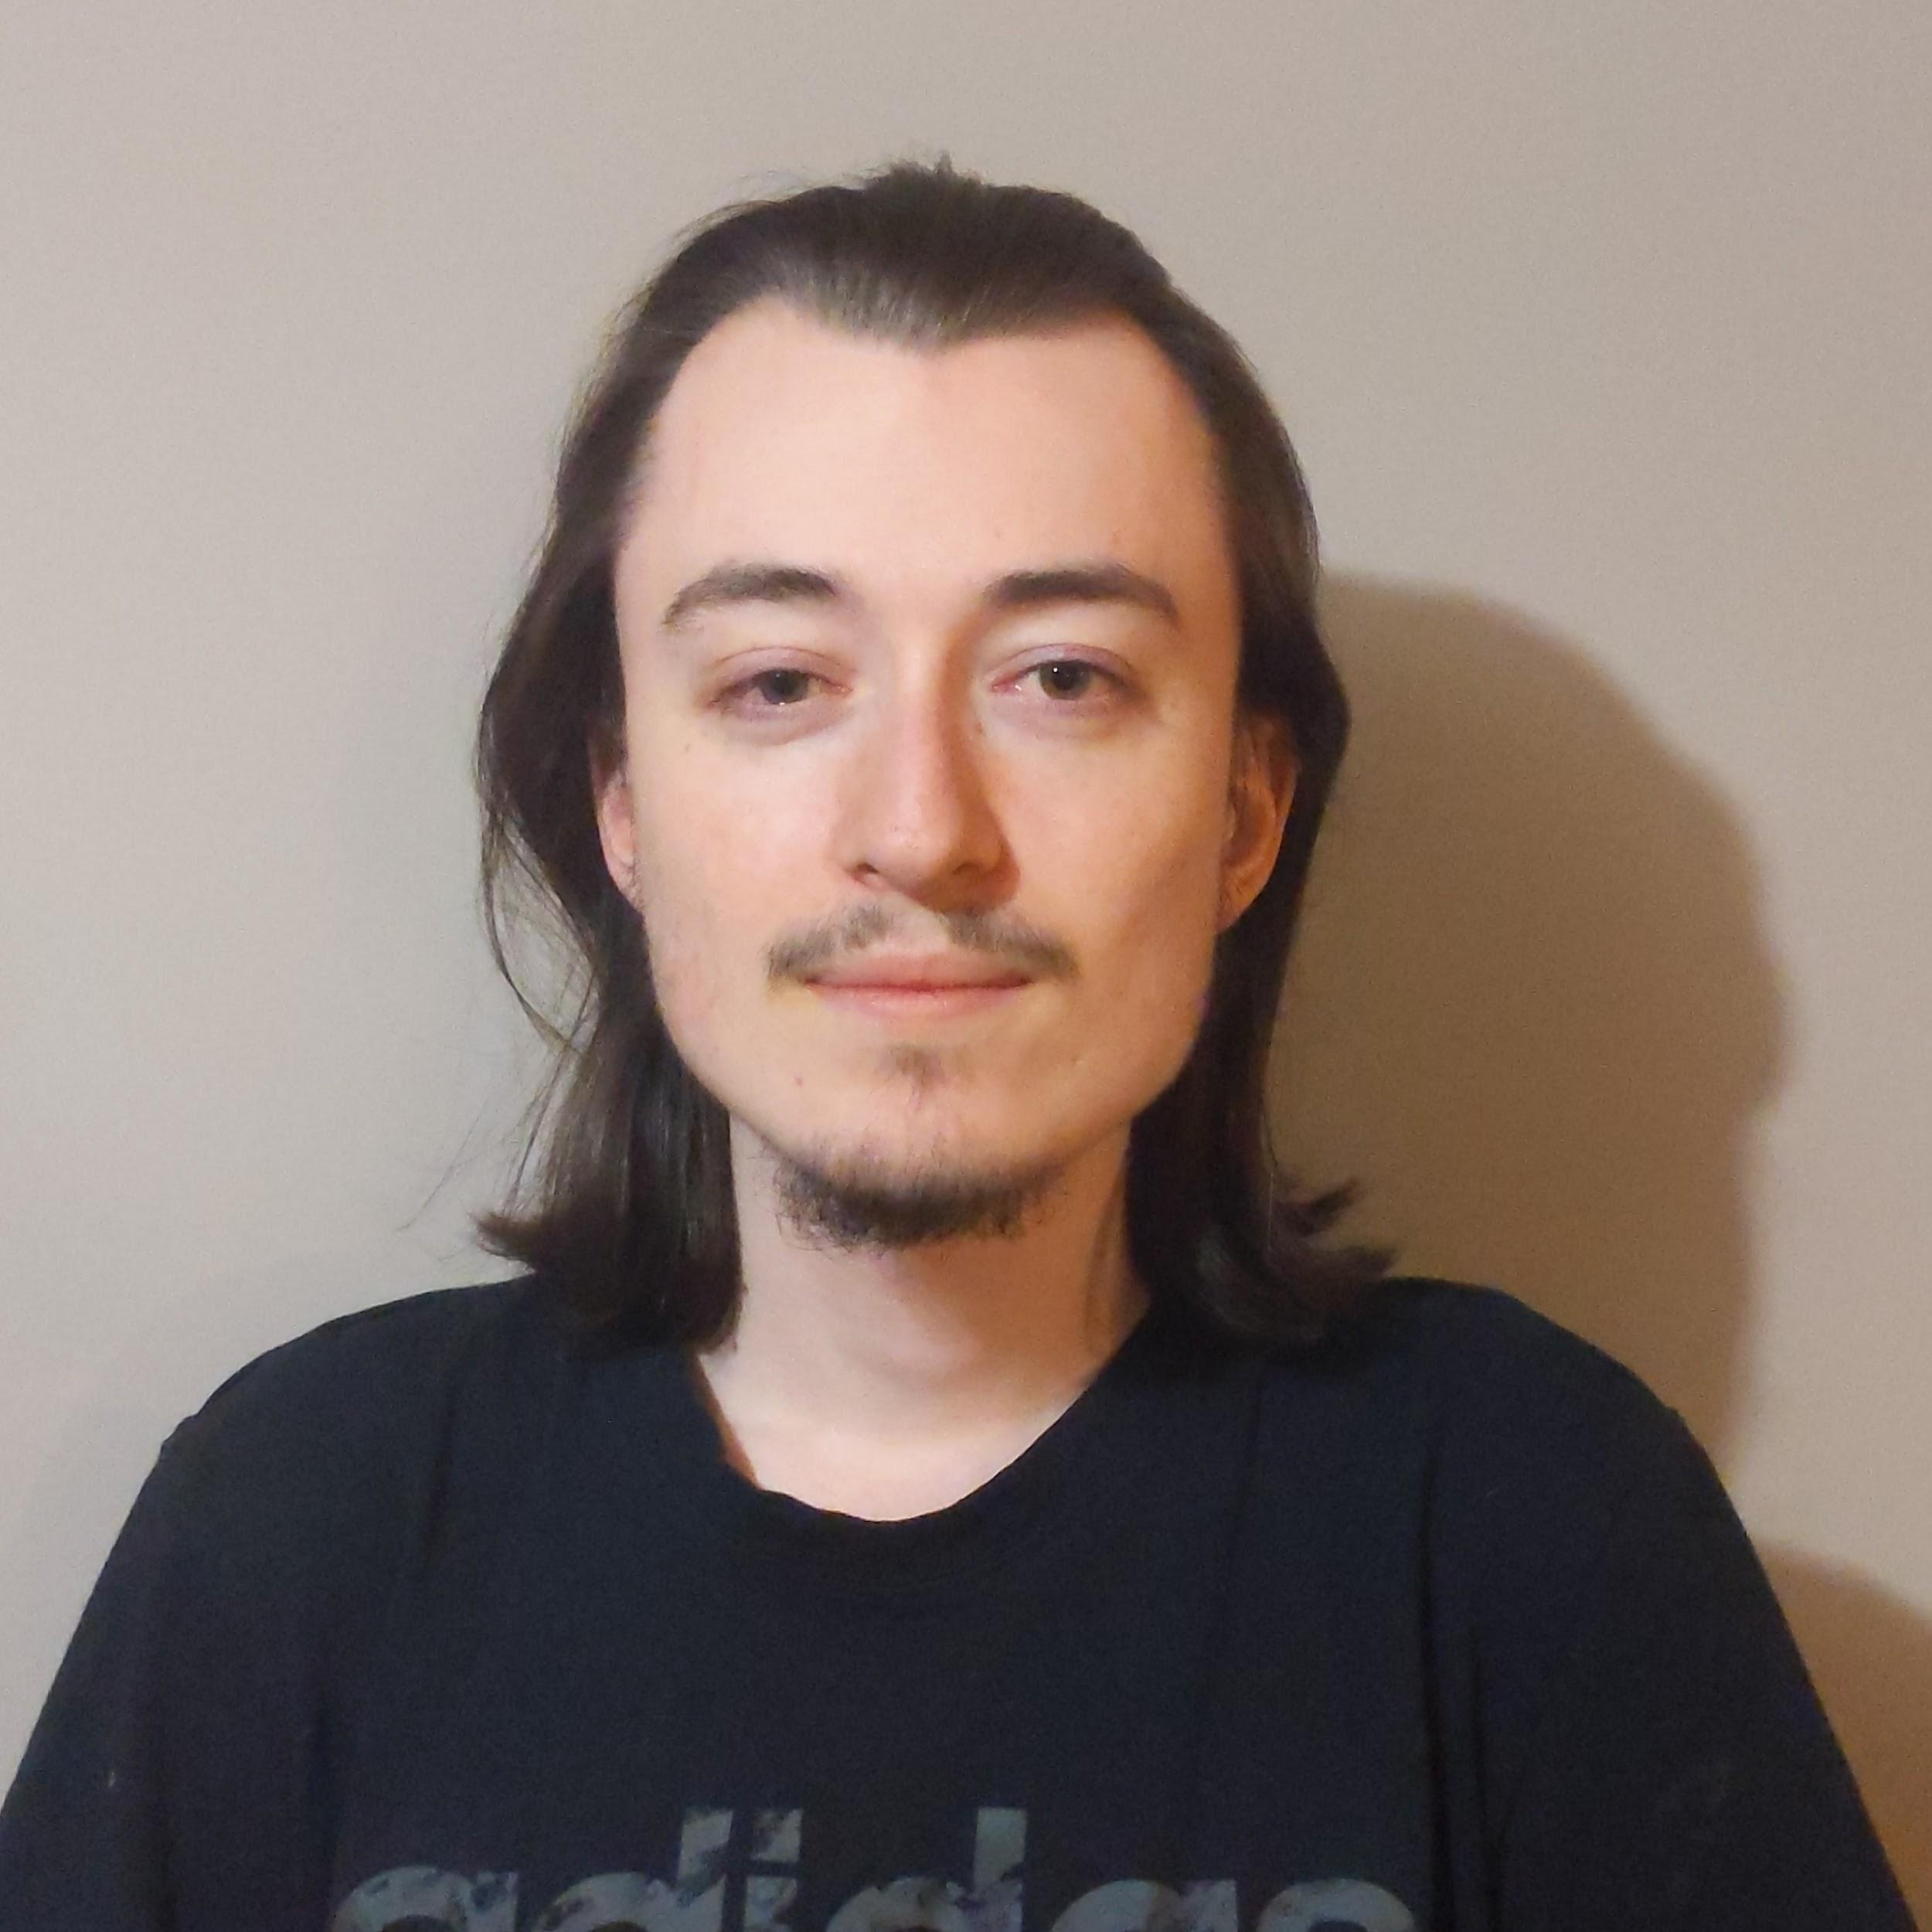
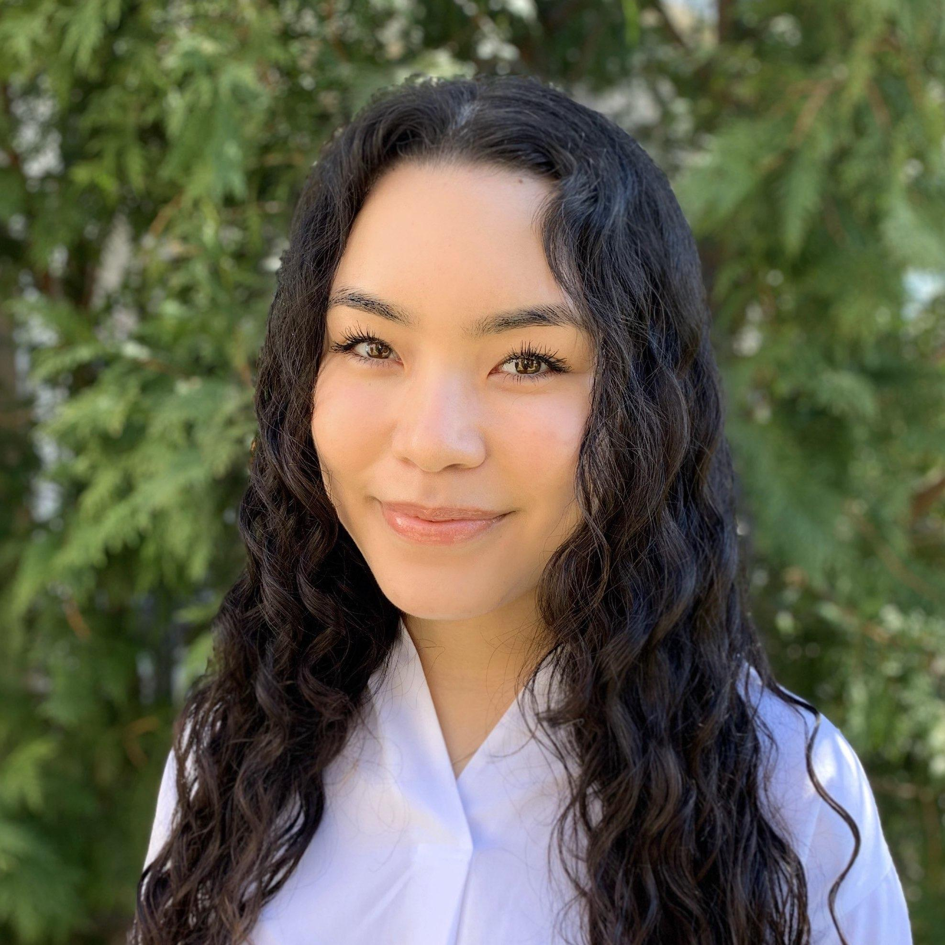
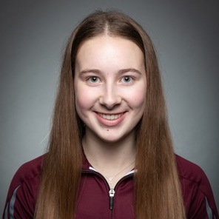
BioGenie Central
Melanie Tambong
Félix Larouche
Vivianne Yee
Emma
Dobson Takoff
Supervisor: Mads Kaern

Slide 2
BIOGENIE
CENTRAL TEAM
THE

Slide 3
TABLE OF CONTENTS
01
03
02
04
Introduction
Our team and our goals
Website
Demonstration
Business plan
Purpose
Conclusion
Closing remarks

Slide 4
INTRODUCTION
The BioGenie Central team is a unique team working to provide support to Mads and any of the research teams

Slide 5
01
OUR GOALS
→ Learn new skills outside of our field of study
→ Further develop skills learned in the classroom

Slide 6
OUTCOMES
Business Plan
Website
To extend the lifetime of the program beyond the Summer 2020 work term
To promote the uOttawa BioTalent program and to generate future interest

Slide 7
02
BUSINESS PLAN

Slide 8
UOTTAWA BIOGENIE
BUSINESS PLAN
Extend the
Lifeline

Slide 9
AREAS COVERED
Operations
Marketing
Who is involved?
Who are we targeting?
Competition
Advertising
Who is our competition and how are we better?
How do we utilize social media and the website?

Slide 10
Future
Development
Fill in the Blanks
Acquire all missing information

Slide 11
03
OUR WEBSITE

Slide 12
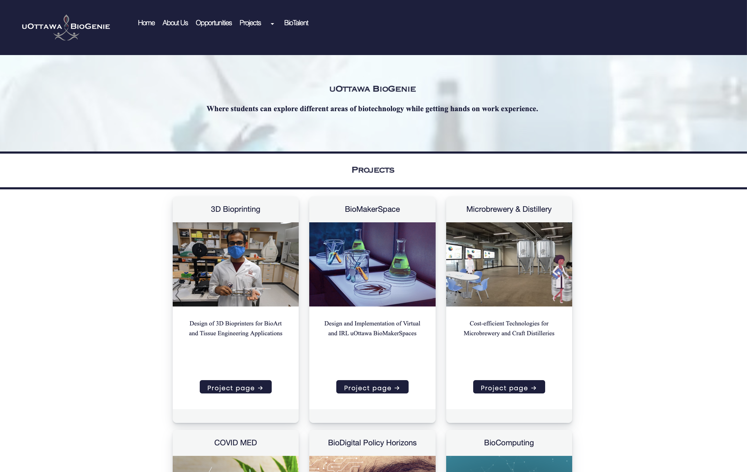
BIOGENIE WEBSITE
Created to promote the uOttawa BioTalent program and to generate future interest
Link to Website

Slide 13
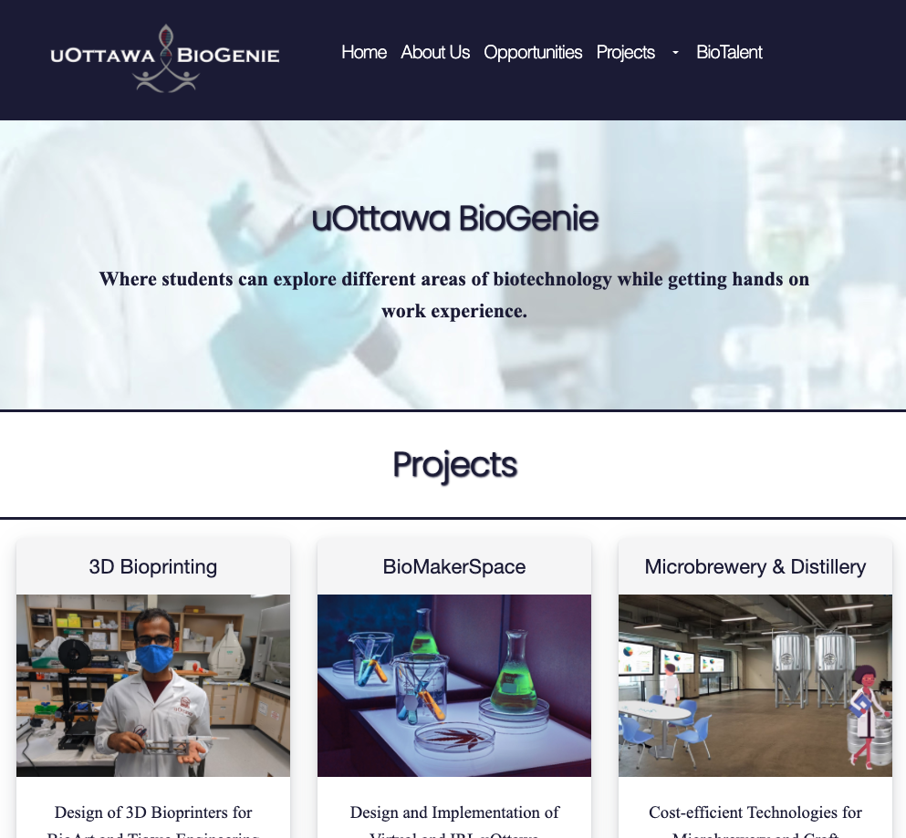
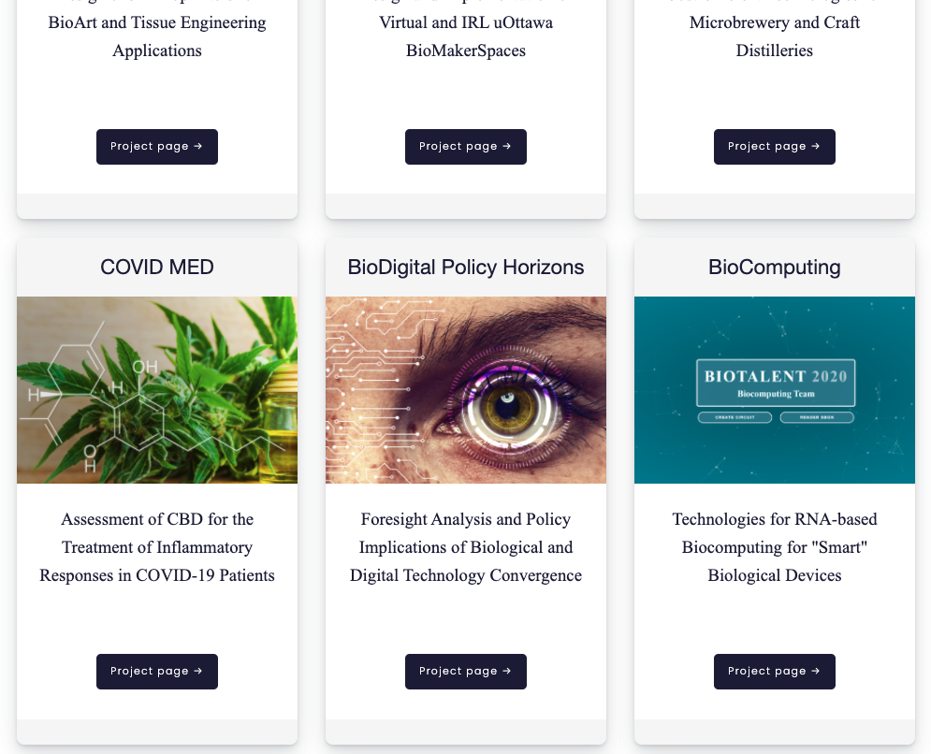
Future Development
Mobile compatible website

Slide 14
THANK YOU!
Visit the BioGenie website at:
biogenie.uottawa.club
CREDITS: This presentation template was created by Slidesgo, including icons by Flaticon, and infographics & images by Freepik.

